Slide 1


Aargh!
I have to teach R
Experiences in the teaching of R
Martin Schneider
Data Scientist
eRum 2016
Notes:
Ok my talk is called Aargh I have to teach R
I chose for the start a picture of this guy because
I guess most people who teach R, have something in coming with Indiana Jones –
They teach R only part-time.
So do I
I work as a Data Scientist and do most of the time project Work for our clients,
But from time to time I have to or get to teach R.

Slide 2

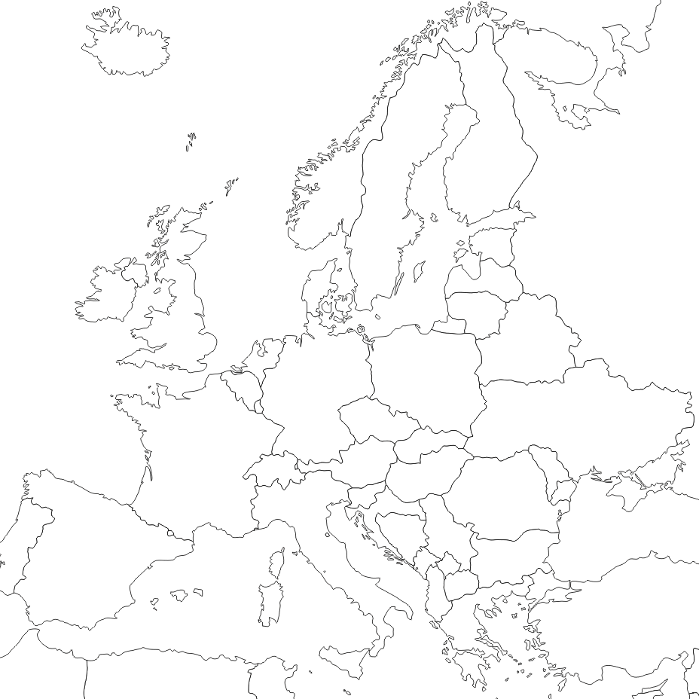

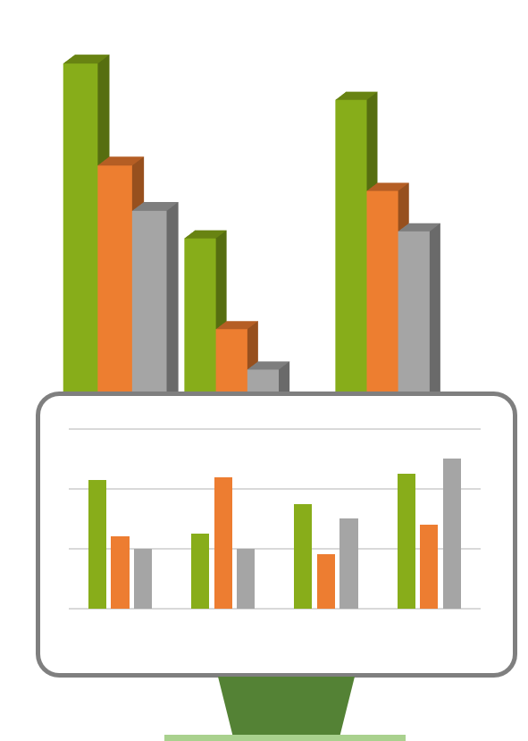

About eoda
Interdisciplinary Team
Statisticians | Engineers | Economists | Sociologist | …
Based in Kassel - Germany
Data Science Consulting, Training, Support, Software and Analytic Services with a focus on R

Slide 3








Motivation and Qualification
Teaching R since
2013
Number of courses
0025
Course Participants
0125
I
Notes:
I am teaching R for about 4 years now, I do around 5-7 courses a year. So I held around 25 courses in total.
Considering an average number of participants from 5, I taught around 125 Participants.

Slide 4
Motivation and Qualification
Teaching R since
2010
Number of courses
0150
Course Participants
1000
WE
Notes:
But I am happy enough to work in a company with other data scientists.
And eoda as a company is teaching R since 2010,
2010 was the release of R.2.11.0,
We held around 150 courses for around 1000 participants, not considering those who visited more than one course

Slide 5






For who?
Wide differing Background
Academics
Business
Notes:
Who are these people in the courses, although they have wide differing backgrounds, we can put them in to two rough categories, Academics and Business.
But when of course we can get more and more granular,
Academics are coming from a variety of fields, economics, sociology, biology, mathematics, computer science, geography, engineering
And regarding business participants there is at least the same variety, maybe even more so

Slide 6
For who?
Wide differing Priorities
We want to do everything perfect, every prerequisite for analysis has to be met.
Academics
Business
Notes:
As they have differing backgrounds, they also have of course differing priorities.
So is a typical sentiment often coming from academics:
We want to do everything perfect, every prerequisite has to be met.
Academics are often more focused on methodical aspects.

Slide 7
For who?
Wide differing Priorities
How much money can we save?
We want to see results
Academics
Business
Notes:
On the other Hand, Business People are often much more result-oriented
In business Participants are often working under a higher time pressure.
Furthermore academics make a point of correctness and reproducibility.
In business, people also want to use R not only for adhoc analysis but also want it to use in production so they focus also on a stable runtime.

Slide 8






For who?
Wide differing preknowledge in Analytic Tools
?
Excel
Notes:
Especially for Beginner courses it makes a difference what tools the participants are already using.
Are they already familiar with programming languages like Java or c++,
Maybe they are already doing data science thinks in python
Or are they using point and click software like spss,
Maybe they are doing really complicated thinks with excel,
Or they start as a complete blank page.
For people with no programming experience the greatest hurdle is usually to write the scripts / to start coding.
People with programming abilities often get lost, in exploring how R differs from the languages they know of

Slide 9
For who?
NONE
Wide differing Statistical Background
NONE
COOL
Notes:
When we teach R, we are most of the time not only teaching R but also statistics or data science concepts.
Although we could also do a separation in topics here, I want to separate here along the skill level.
We can have people with no background, that’s totally cool, because I am there to teach people something,

Slide 10
For who?
Wide differing Statistical Background
COOL
A LOT
A LOT
Notes:
When we have the people who have a deep statistical knowledge that’s cool as well, so we focus more on R itself

Slide 11
For who?
SOME
Wide differing Statistical Background
Dangerous
half knowledge
SOME
Notes:
But then we have the People who have some knowledge, those can be a little difficult sometimes. Because opposite to those with a lot of knowledge those guys want to show what they know.
My first training was Multivariate Statistics with R at a university, In the training was a dr. in statistics (dr. Mario) which made me really nervous, and a lot of his students and coworkers.
The doctor showed a strong interest and was very happy with the training, but his people where constantly looking and talking to him for confirmation.

Slide 12
For who?
I want to start with
statistical analysis
Wide differing Personal Goals
I‘m already using SPSS but I heard a lot of R so I wanted to take a look
Notes:
All these aspects cumulate in differing Personal Goals. We know that it is usually better to follow an intrinsic motivation then extrinsic.
One intrinsic motivation is that people are starting on blank page, and chose simply R without to much thinking about it, maybe because its open source.
Another motivation I often come across, is that people are constantly hearing what you can do for great thinks with R and want to take a look,
In academics people often have a Method in mind they want to use, and read papers in which R was used, and want to build on this research

Slide 13
For who?
I want to start with
statistical analysis
Wide differing Personal Goals?
I‘m already using SPSS but I heard a lot of R so I wanted to take a look
I‘m already using Excel and everything is working fine
but my boss said…
Academics
Business
Notes:
We get problems when people are missing this kind of intrinsic Motivation.
Especially in Business it can happen that we have participants who are in the training against their own free will. Like our friend here who is already using excel, and doesn’t understand why he should learn something else.

Slide 14

Package updates
Recurring Problems
Notes:
So now that we have a picture of those who are sitting in front of us in a training, lets take a look at the challenges we have to face when we teach R.
Thanks to the R community, we need to constantly update our material,
packages become so popular that they are almost essential. Like dplyr for data management or caret for data mining.
Or thanks to package updates, used code is deprecated.

Slide 15



Recurring Problems
diverse classes
Notes:
Usually we have to deal with diverse classes, and we have at least one of these extreme characters.
roadrunner stands for those kind of people who are really fast.
Ist often temping to go with their pace, because its the most fun.
But we should try to channel their energy, maybe they can help others, or try new things in their free time.
Droopy Dog stands for the people who are a little bit slower or easygoing,
its also tempting to go with their pace, because we dont want to leave anyone behind
but if you focus too much on those, you have the danger that you will not finish everything you planned
and duffy duck is the worst, sometimes you have people in the course with a destructive character, who are constantly bad mouthing everything, in this case the most important think is to keep calm and maybe talk to them alone during coffeebreak

Slide 16

Recurring Problems
In R there are usually lots of different ways
to solve a problem
We did this already this way, why are we doing it another way?
Notes:
Whats great about R is that there is usually more than one way to do something. But for people learning R this is sometimes difficult to wrap their head around.
Like different functions which do the same things, subset and dplyrs filter for example

Slide 17

Recurring Problems
Steep learning curve
What does this Error Message mean? I‘m having problems solving this exercise.
I will never under-stand R
This is in SPSS much easier
Notes:
R has a really steep learning curve, so we need to take care that people stay motivated, and or learn how to handle/accept frustration.
So the teacher needs to communication that its not a problem or unusual to get errors.

Slide 18

Recurring Problems
Technical hurdles
I´m missing the permission to install packages
I have to use external
software
Notes:
Technical Hurdles can always happen,
Besides the obvious challenge everyone has to face, that they need the first half hour of a training to get the projector running. Where are some specialties we have to face when teaching R. Like missing permissions to install software/packages. Missing Internet Connections. And it is often difficult when you use external software, you can run into problems with the installation of packages like rjava, or if you want to do fancy database stuff

Slide 19
Usual Course
Small Part of Presentation
Presentation
Notes:
So what does a typical course contain?
We do mostly courses, which take two days, 9 to 5 in rough 90 minute chunks.
Usually a course consists of a presentation part, which is most of the time the smallest part.
When we are Writing and developing code together, often I prepare my code beforehand and treat it like music notes. It’s no problem to diverge from the notes, but you always keep something to fall back to. Maybe, a little bit like jazz.
And we need exercises so people can test what they learn, and maybe try a thing or two for themselves.

Slide 20
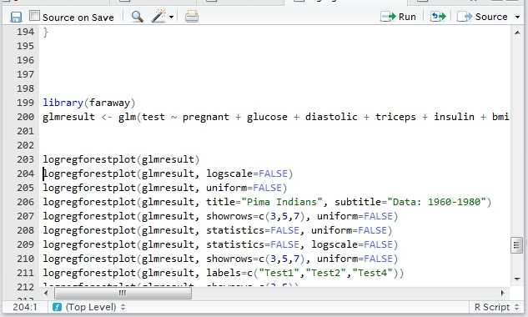
Usual Course
Writing code in front
cars <- read.csv(file = "Data/carsMO.csv", stringsAsFactors = FALSE)
select(cars, Manufacturer, Modell, contains("sales", ignore.case = TRUE))
select(cars, Manufacturer, Modell, Sales:Sales_grouped)
mutate(cars, weight_to_hp = HP/Weight) %>%
filter(weight_to_hp > mean(weight_to_hp, na.rm = TRUE)) %>%
arrange(desc(weight_to_hp))%>%
select(Modell, weight_to_hp)
abs_loss_data <- cars %>%
mutate(absolute_loss = Purchase_price - Resaleprice) %>%
arrange(desc(absolute_loss)) %>%
select(Modell, contains("price"), absolute_loss) %>%
filter(!is.na(absolute_loss))
Slowdown when writing code
Notes:
When writing code together with the class, its important to keep the pace in mind. Often you need yourself to slow down and don’t write in your usual speed.
And you need to be beware of bottlenecks, which cause participants to fall behind.
Typical bottlenecks are: Package installations, using functions from loaded packages, complex code of course, external software. And also a trainer can make errors, if you do so be sure to explain what went wrong and that everybody corrected the error.
Fehler die man beim schreiben macht korrigieren und erklären, auf Flaschenhälse achten (Paket installieren o.Ä.), Code der die Problemstellen aufzeigt (Highlighten und daran erklären), allgemeines Problem: Kurse die zusätzliche Software einbeziehen (Hadoop => Big Data Schulung) oder unterschiedliche Hardware Voraussetzungen (Mac User)

Slide 21



Usual Course
Excercises
Now that you know, what a list is please load this dataset, apply a cluster analysis on it and create an appealing report
Don‘t make it to difficult
Notes:
When doing exercises, don’t make it to difficult. Learnig R is already hard enough, don’t frustrate your students

Slide 22



Usual Course
Excercises
Now that you know how to extract the first element from a list, please extract the second
Don‘t make it to easy
Notes:
But don’t make it to easy either.
Don`t do simple transition tasks.
Of course in a diverse setting, its possible to have people who are bored of an exercise and others who are challenged by it.
What works is to have something in your backhand for those who are quicker,
When you’re already finished you can try to find out why xy is working like that.

Slide 23


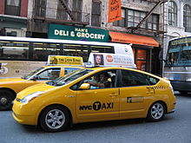
Example Data
Usual Course
MT Cars
NYC Taxi Data
Iris
Notes:
When choosing example data, try to use data from fields there where youre participants are not experts in, otherwise they will start discussing plausibility and get lost in details

Slide 24

Wishfull Thinking
workshop element attached to the course
smaller chunks of training sessions
Notes:
a half or one day extra for a workshop element, where you can consult participants while they are solving real use cases/work problems
and smaller chunks of training sessions, maybe only half a day of class with homework tasks
.

Slide 25





The Data Science Specialists.
eoda GmbH
Universitätsplatz 12
34127 Kassel - Germany
www.eoda.de/en
info@eoda.de
+49 561 202724-40
@eodaGmbH
blog.eoda.de
@eodaGmbH
eodaGmbH

